Slide 1
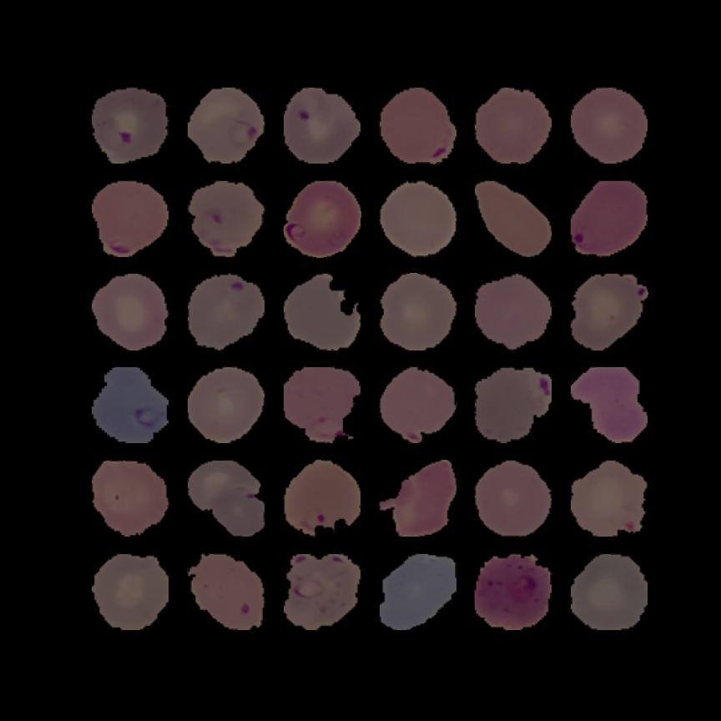
Malaria Detection Deep Learning
MIT Applied Data Science Program
Enrique Olmos

Slide 2
Table of Contents
Executive Summary
Identifying the problem
Malaria’s Impact worldwide
Solution Design
Performance
Final Considerations

Slide 3
Executive summary:
This project proposes a computer vision classification model able to discriminate between uninfected and parasitized red blood cells.
It could be a viable and scalable solution to facilitate the access to reliable, fast and inexpensive diagnosis of malaria.
The model identifies whether a given input image of a red blood cell is that of one infected with malaria or not, and classifies the same as parasitized or uninfected, respectively.

Slide 4
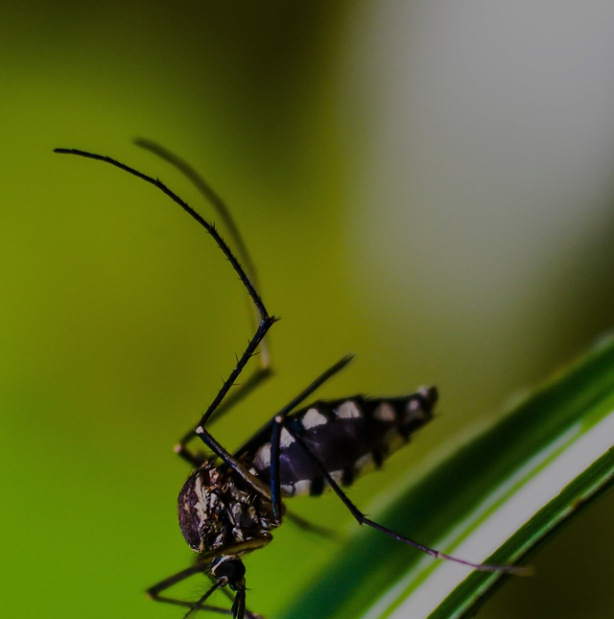
Identifying the problem:

Slide 5
Identifying the problem:
Malaria is an acute febrile illness caused by Plasmodium parasites, spread to people through the bites of infected mosquitoes.

Slide 6
Identifying the problem:
Malaria is an acute febrile illness caused by Plasmodium parasites, spread to people through the bites of infected mosquitoes.
Early diagnosis and treatment of malaria reduces disease, prevents deaths, and helps reduce transmission.

Slide 7
Identifying the problem:
Malaria is an acute febrile illness caused by Plasmodium parasites, spread to people through the bites of infected mosquitoes.
Early diagnosis and treatment of malaria reduces disease, prevents deaths, and helps reduce transmission.
Traditional diagnostics often require trained professionals to perform them, and their accuracy depends largely on the skill of these professionals.

Slide 8
Identifying the problem:
Malaria is an acute febrile illness caused by Plasmodium parasites, spread to people through the bites of infected mosquitoes.
Early diagnosis and treatment of malaria reduces disease, prevents deaths, and helps reduce transmission.
Traditional diagnostics often require trained professionals to perform them, and their accuracy depends largely on the skill of these professionals.
Areas with the highest incidence of malaria cannot cope with the demand for diagnosis and treatment.

Slide 9
Malaria’s Impact worldwide:

Slide 10
Malaria’s Impact worldwide:
24Hs
Left unattended severe illness and death can occur within 24hs.1
1. Malaria. World Health Organization. https://www.who.int/news-room/fact-sheets/detail/malaria

Slide 11
Malaria’s Impact worldwide:
24Hs
627,000
Left unattended severe illness and death can occur within 24hs.1
Estimated Malaria Deaths in 2020. 1
1. Malaria. World Health Organization. https://www.who.int/news-room/fact-sheets/detail/malaria

Slide 12
Malaria’s Impact worldwide:
24Hs
627,000
241
Million
Left unattended severe illness and death can occur within 24hs.1
Estimated Malaria Deaths in 2020. 1
Cases of Malaria Worldwide 2020. 1
1. Malaria. World Health Organization. https://www.who.int/news-room/fact-sheets/detail/malaria

Slide 13
Malaria’s Impact worldwide:
24Hs
627,000
241
Million
Left unattended severe illness and death can occur within 24hs.1
Estimated Malaria Deaths in 2020. 1
Cases of Malaria Worldwide 2020. 1
50%
Percentage of world population at risk of malaria in 2020. 1
1. Malaria. World Health Organization. https://www.who.int/news-room/fact-sheets/detail/malaria

Slide 14
Malaria’s Impact worldwide:
24Hs
627,000
241
Million
Left unattended severe illness and death can occur within 24hs.1
Estimated Malaria Deaths in 2020. 1
Cases of Malaria Worldwide 2020. 1
50%
96%
Percentage of world population at risk of malaria in 2020. 1
Percentage of malaria deaths corresponding to the African Region in 2020.1
1. Malaria. World Health Organization. https://www.who.int/news-room/fact-sheets/detail/malaria

Slide 15
Malaria’s Impact worldwide:
24Hs
627,000
241
Million
Left unattended severe illness and death can occur within 24hs.1
Estimated Malaria Deaths in 2020. 1
Cases of Malaria Worldwide 2020. 1
96%
12
Billion
USD
50%
Percentage of world population at risk of malaria in 2020. 1
Percentage of malaria deaths corresponding to the African Region in 2020.1
Estimated malaria direct costs per year.2
1. Malaria. World Health Organization. https://www.who.int/news-room/fact-sheets/detail/malaria
2. Malaria’s Impact Worldwide . Centers for Desease Control and Prevention (CDC): https://www.cdc.gov/malaria/diagnosis_treatment/diagnostic_tools.html#tabs-1-1

Slide 16
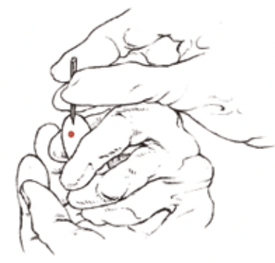
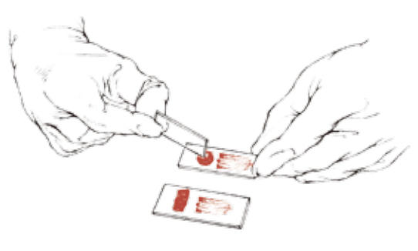
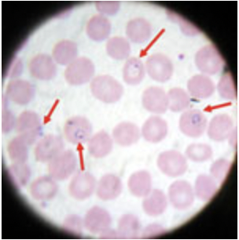
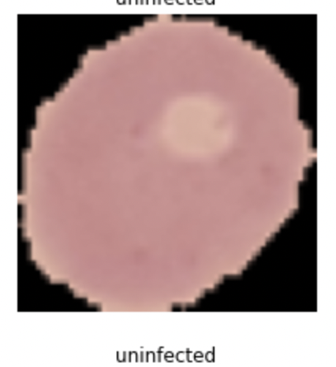
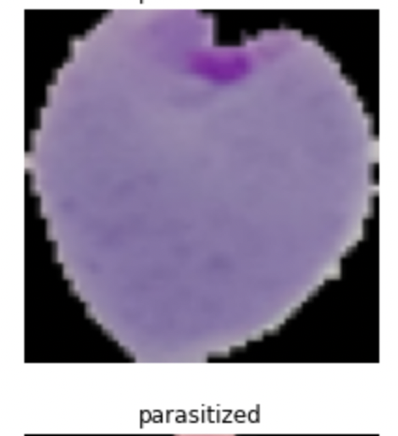

Solution Design:
Sample collection
Sample preparation and staining
Microscopic Image obtention
Uninfected
Input images
ClassificationModel
Labeled output
Parasitized
Treatment if necessary

Slide 17
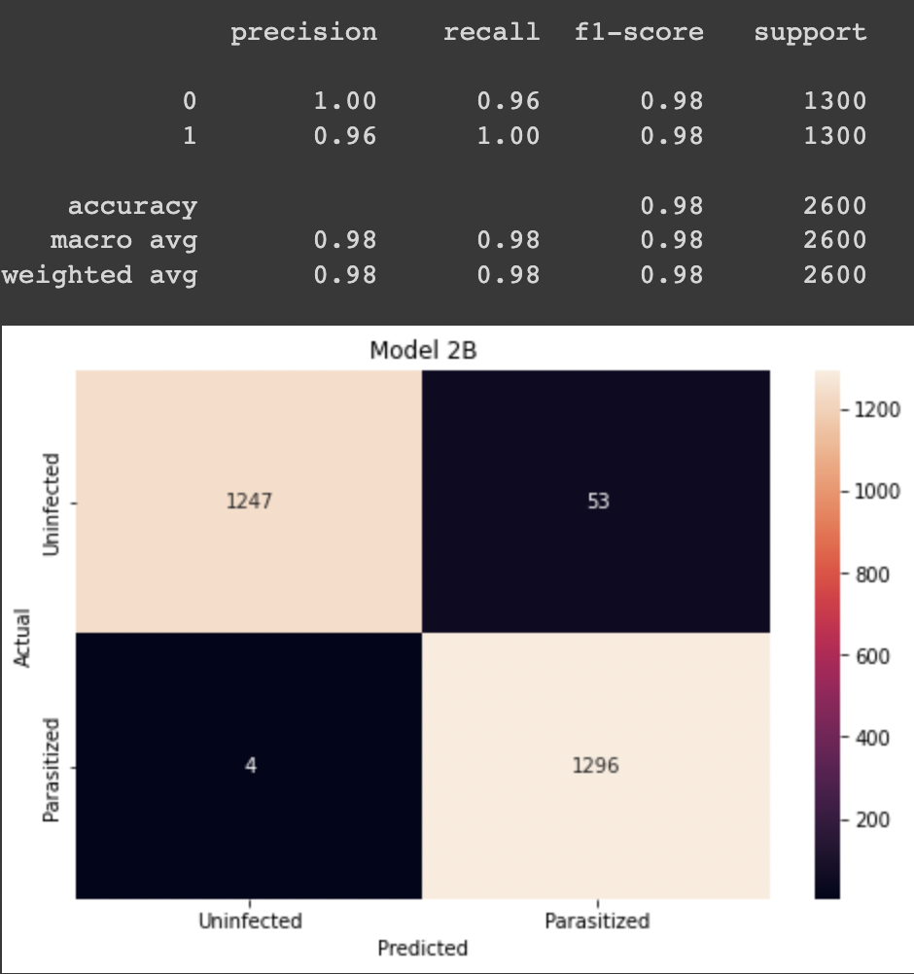
Solution Performance:
The model is based on a convolutional neural network (CNN).
It was trained with 24958 images (50% of parasitized and 50% uninfected red cells,
and tested by classifying 2600 images of which: 1300 corresponded to the parasitized case and 1300 to the uninfected class.
True positive rate (Sensitivity): 1296/1300 (99.69%)
False negative rate: 4/1300 ( 0.31%)
True negative rate (Specificity) 1247/1300 (95.92%)
False positive rate: 53/1300 ( 4.07%)
1247
53
4
1296
We prioritize that the level of false negatives to be as low as possible, even if that gives a few extra false positives.
There is a trade off between false negatives and false positives, but the ultimate goal is to avoid people dying of malaria because of a wrong or late diagnosis.
On the other hand, a false positive can be solved by retesting (in case of positive without any symptoms) or given anti-malaria treatment, which will not be harmful (but implies the misuse of a scarce resource such as medicine and time).
Confusion matrix and classification report.

Slide 18
Benefits:
Deep neural network-based imaging diagnose is not only feasible, but also a cost-effective and rapidly scalable solution to the problem of early malaria diagnosis.
Reduces disease by allowing early treatment of malaria.
Prevents deaths by enabling early treatment of malaria, especially when infected with the most dangerous species of parasites, which require treatment within 24 hours.
Helps reduce transmission by early treatment of those infected before they can transmit malaria.
Can provide high quality surveillance data for decision making, as the data is already digitized, could be easily uploaded every X months, and in doing so, update the database. This information could be key in strategic planning (such as dispatching drugs to a particular location prior to a disease outbreak).

Slide 19
Final Considerations:
While a promising model has been produced, there are a number of key factors to consider first:
Public awareness campaign. It is essential for the population to come forward at the first sign of the disease and have confidence in the treatment.
Image acquisition: quick access to trained personnel to obtain the blood sample, perform the staining correctly and have the means to capture an image clear enough to enter into the model.
Hardware: ample access to appropriate hardware is essential to acquire the image and run the model.
Access to treatment: access to drugs for immediate and appropriate treatment once a positive diagnosis is made, as well as follow-up of those cases.
Data surveillance. The data obtained, images, diagnosis and other relevant anamnesis data (anonymized) should be uploaded into a database to not only improve the performance of this model, but also to identify areas with the most severe types of malaria (P. falciparum and P. vivax) and provide high quality surveillance data for decision making.
The large-scale plan. While the initial goal is to facilitate diagnosis and provide appropriate treatment to reduce the number of malaria deaths, there must also be a large-scale plan to combat the parasite to prevent the spread of infection.

Slide 20
Thank you!

